Slide 1
CS 111: Introduction to Computer Science
Dr. Tom Stephens

Slide 2
Who is Dr. Stephens Anyway?
Education
BS Physics 1996 – BYU
MS Astronomy 1999 – NMSU
Ph.D. Astronomy 2003 – NMSU
MS Library and Information Science – 2016 – UNT
Work
Assistant Professor – BYU – Dec 2020 – present
Software Developer & Manager – NASA – 2003-15, 2017-20, now part-time
Physical and Mathematical Sciences Librarian – 2014-17

Slide 3
Who is Dr. Stephens Anyway?

Slide 4
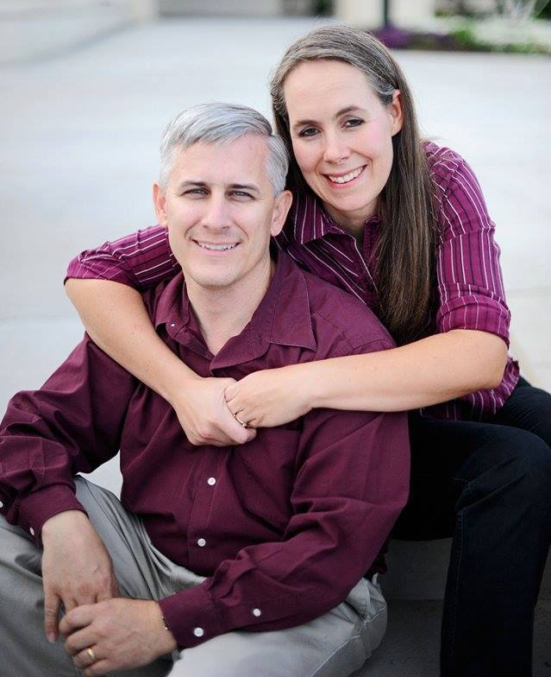
Who is Dr. Stephens Anyway?
Father of 7
Current Calling: Ward Temple & Family History Leader
Hobbies
Hiking/Camping
Reading & Writing (1 self-published sci-fi novel)
Role-Playing Games – published a quarterly game magazine & more general blog
3D Modeling and Printing
Playing Minecraft and Roblox with the little guys (and their cousins)

Slide 5
Contacting Dr. Stephens
Office – 2256 TMCB – feel free to drop in anytime I’m there.
E-mail – tstephen@cs.byu.edu – This is the best way to reach me.
Office Hours – TBD or by appointment
Stalk me on-line
I'm on the class Discord
@dagorym on most online sites
Tom Stephens on Facebook

Slide 6
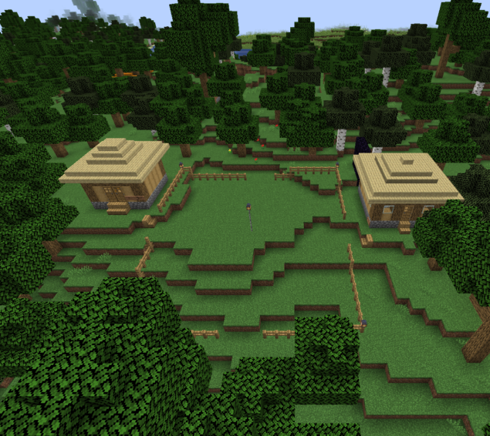
My Minecraft Server
For those Minecraft players in the class, I have a server set up you’re welcome to join.
Details can be found at:
https://expandingfrontier.com/cs-minecraft-server/

Slide 7
BYU Minecraft Club
I'm also the Faculty Advisor for the BYU Minecraft Club
Club Discord: https://discord.gg/cx2PuAmR23
The club runs multiple servers including
The main survival world
An anarchy server
The Campus Creation world where they are recreating BYU Campus
There is also a coding group that works on mods and resource packs for the server.

Slide 8
Questions?

