Slide 1
Environments, Tuples, & Dictionaries

Slide 2
Environments and Frames

Slide 3
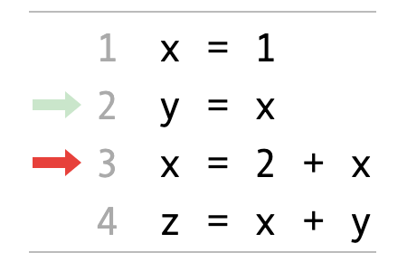
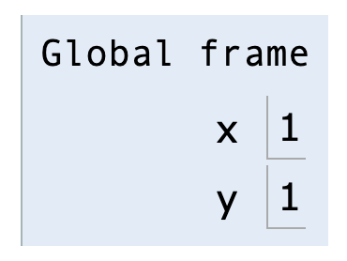
Environment Diagrams
An environment diagram is a visualization of how Python interprets a program. Use the free website PythonTutor to generate diagrams. View example
Code (left) | Frames (right)
Arrows indicate the order of execution. Green = just executed, red = up next. | Each name is bound to a value. Within a frame, each name cannot be repeated.

Slide 4
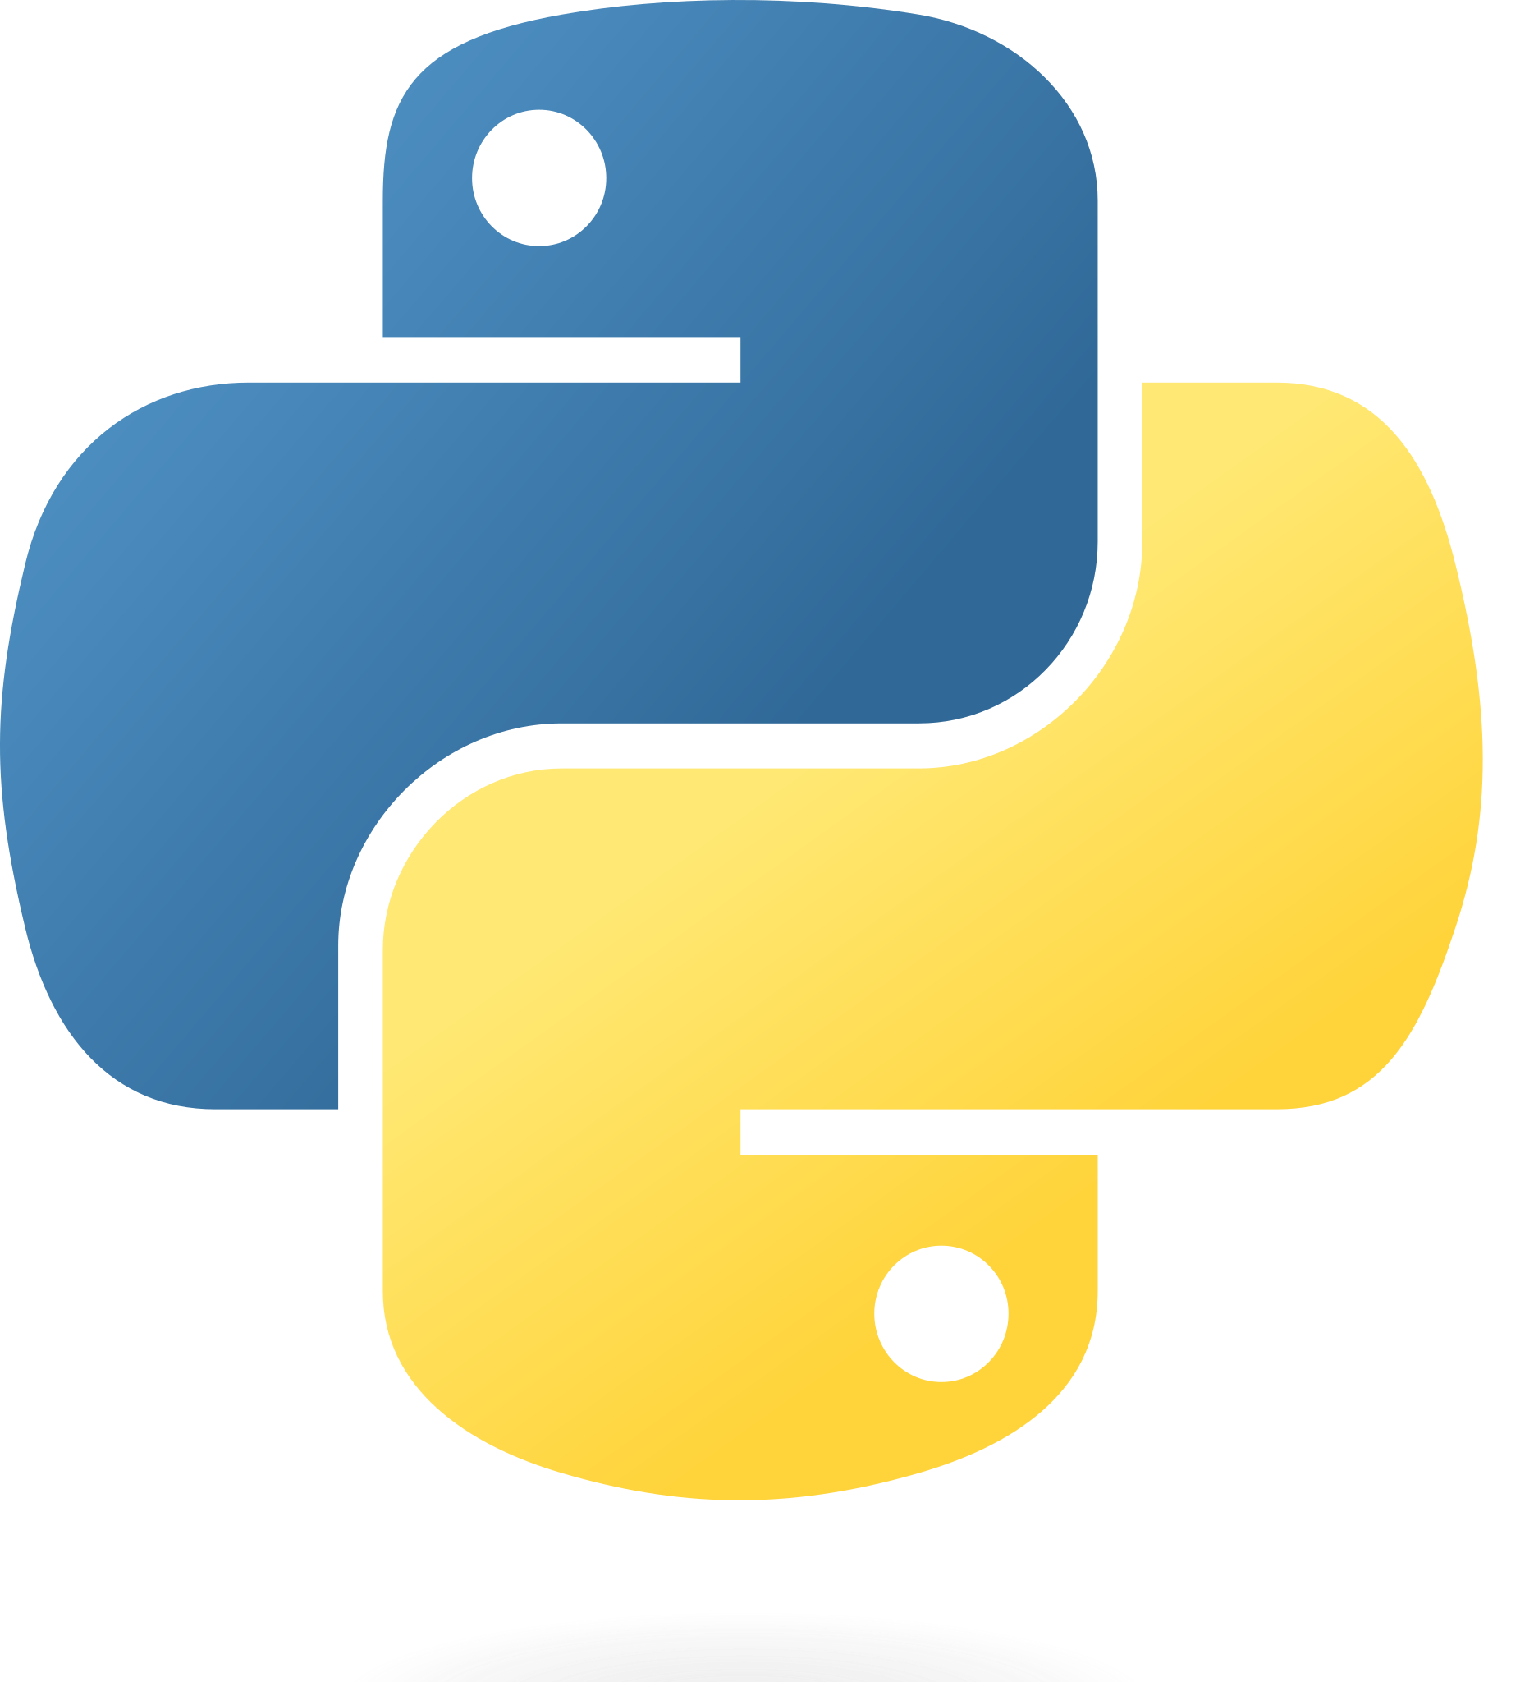
Assignments in Environment diagrams
How Python interprets an assignment statement:
Evaluate the expression to the right of =.
Bind the expression's value to the name that's on the left side of the = sign.
View in PythonTutor

Slide 5
Functions in environment diagrams
How Python interprets a def statement:
It creates a function with the name and parameters
It sets the function body to everything indented after the first line
It binds the function name to that function body (similar to an assignment statement)
View in PythonTutor

Slide 6
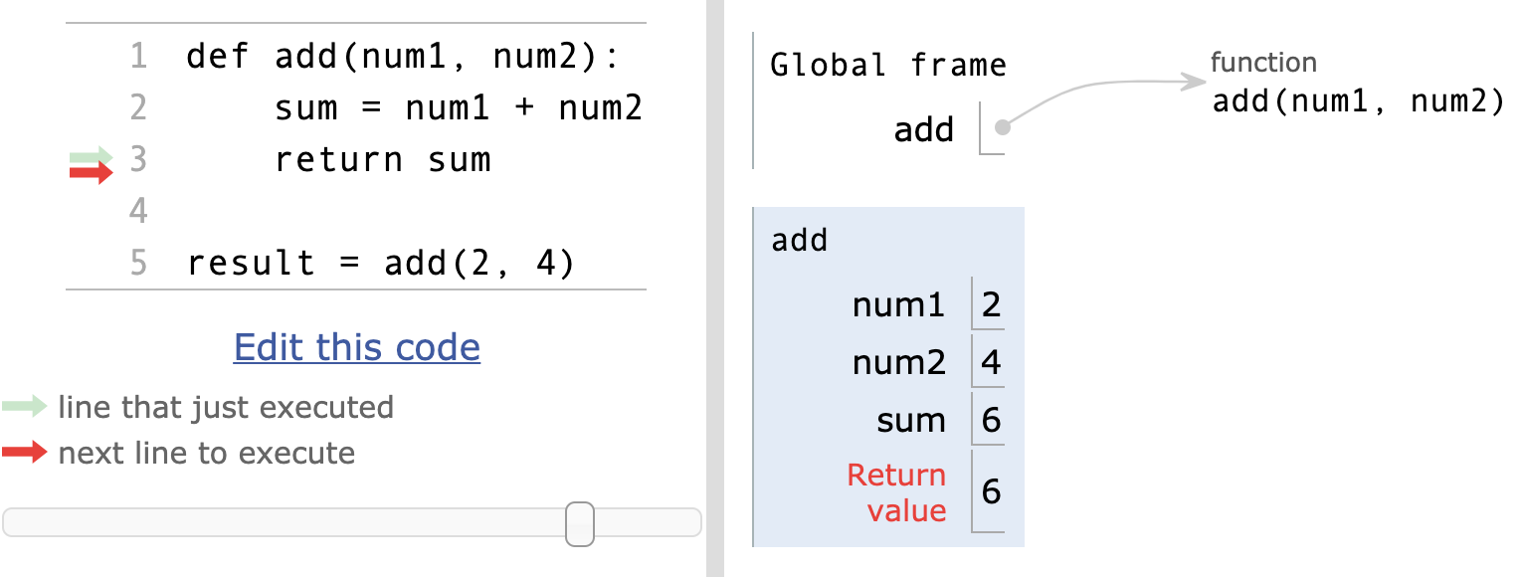
Function calls in environment diagrams
How Python interprets a function call:
It creates a new frame in the environment
It binds the function call's arguments to the parameters in that frame
It executes the body of the function in the new frame
View in PythonTutor

Slide 7
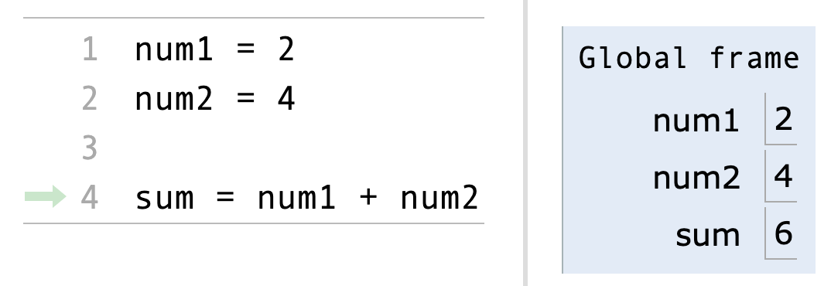
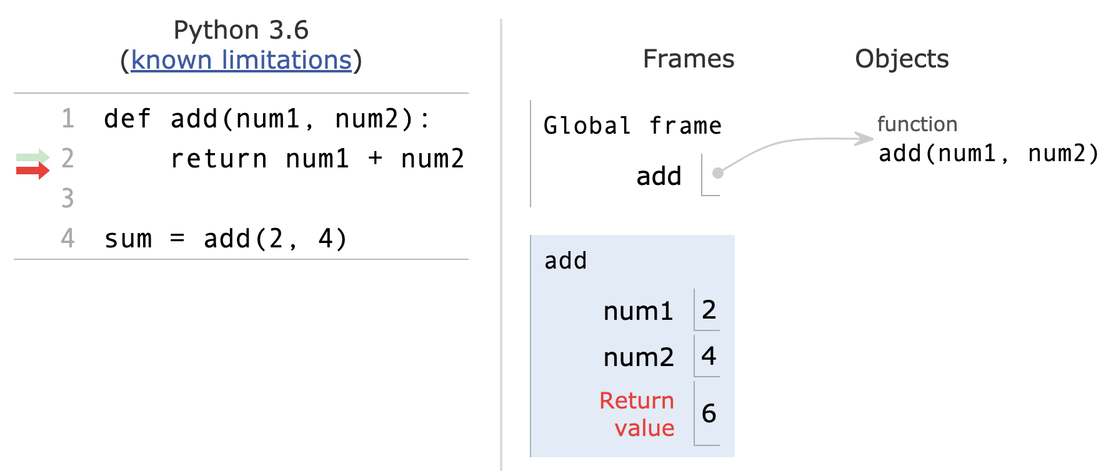
Names and environments
All Python code is evaluated in the context of an environment, which is a sequence of frames.
We've seen two possible environments:
Global Frame
Function's local frame, child of Global frame

Slide 8
Name lookup rules
How Python looks up names in a user-defined function:
Look it up in the local frame
If name isn't in local frame, look it up in the global frame
If name isn't in either frame, throw a NameError
*This is simplified since we haven't learned all the Python features that complicate the rules.

Slide 9
Name lookup example #1
def exclamify(text):
start_exclaim = "¡"
end_exclaim = "!"
return start_exclaim + text + end_exclaim
exclamify("the snails are eating my lupines")
On line 4, which frame is start_exclaim found in?
The local frame for exclamify
On line 4, Which frame is text found in?
The local frame for exclamify
On line 6, which frame is exclamify found in?
The global frame
View in PythonTutor

Slide 10
Name lookup example #2
start_exclaim = "¡"
end_exclaim = "❣️"
def exclamify(text):
return start_exclaim + text + end_exclaim
exclamify("the voles are digging such holes")
On line 5, which frame is start_exclaim found in?
The global frame
On line 5, Which frame is text found in?
The local frame for exclamify
On line 6, which frame is exclamify found in?
The global frame
View in PythonTutor

Slide 11
Name lookup example #3
def exclamify(text):
end_exclaim = "⁉️️️"
return start_exclaim + text + end_exclaim
exclamify("the voles are digging such holes")
Which name will cause a NameError?
The start_exclaim name, since it was never assigned.
When will that error happen?
It will happen when exclamify is called and Python tries to execute the return statement.
View in PythonTutor

Slide 13
Tuples

Slide 14
Tuples
A tuple is an immutable sequence. It's like a list, but no mutation allowed!
An empty tuple:
A tuple with multiple elements:
A tuple with a single element: 🙀
empty = ()
# or
empty = tuple()
conditions = ('rain', 'shine')
# or
conditions = 'rain', 'shine'
oogly = (61,)
# or
oogly = 61,

Slide 15
Creating a tuple from another sequence
Just like the list() function creates a list from an iterable sequence (like a list or string), the tuple() functions creates a tuple from an iterable sequence
digit_list = [0,1,2,3,4,5,6,7,8,9]
digit_tuple = tuple(digit_list)
# (0,1,2,3,4,5,6,7,8,9)

Slide 16
Tuple operations
Many of a list's read-only operations work on tuples.
Combining tuples into a new tuple:
Checking containment:
Accessing elements:
Slicing:
# ('come', '☂', 'or', '☼')
('come', '☂') + ('or', '☼')
'wally' in ('wall-e', 'wallace', 'waldo')
# False
conditions = ('rain', 'shine')
conditions[1]
# 'shine'
digits = (0,1,2,3,4,5,6,7,8,9)
numbers = digits[3:8]
# (3,4,5,6,7)

Slide 18
Dictionaries

Slide 19
Dictionaries
A dict is a mapping of key-value pairs
states = {
"CA": "California",
"DE": "Delaware",
"NY": "New York",
"TX": "Texas",
"WY": "Wyoming"
}
>>> len(states)
5
>>> "CA" in states
True
>>> "ZZ" in states
False
Notes:
The dictionary slides need to move to an earlier lecture

Slide 20
Dictionary selection
words = {
"más": "more",
"otro": "other",
"agua": "water"
}
Select a value:
>>> words["otro"]
'other'
>>> first_word = "agua"
>>> words[first_word]
'water'
>>> words["pavo"]
KeyError: pavo
>>> words.get("pavo", "🤔")
'🤔'

Slide 21
Dictionary rules
A key cannot be a list or dictionary (or any mutable type)
All keys in a dictionary are distinct (there can only be one value per key)
The values can be any type, however!
spiders = {
"smeringopus": {
"name": "Pale Daddy Long-leg",
"length": 7
},
"holocnemus pluchei": {
"name": "Marbled cellar spider",
"length": (5, 7)
}
}

Slide 22
Dictionary iteration
insects = {"spiders": 8, "centipedes": 100, "bees": 6}
for name in insects:
print(insects[name])
What will be the order of items?
Keys are iterated over in the order they are first added.
8 100 6

Slide 23
Dictionary comprehensions
General syntax
Notice the curly braces {} instead of brackets []
There are two items before the for keyword: the key and the value separated by a colon
Example
{key: value for <name> in <iter exp>}
{x: x*x for x in range(3,6)}
# {3: 9, 4: 16, 5: 25}

Slide 25
Incremental development

Slide 26
Incremental Program Development
There is often the temptation to write large sections of code all at once before testing any of it
This is usually a bad idea as we need to search through all the code written to find any bug introduced
A better method is to write a little bit of code, test it, then write a bit more
Bugs are localized
We know we have working code every step of the way

Slide 27
Stepwise Refinement
Stepwise refinement is a process that goes hand in hand with incremental development
You start by taking a large problem and dividing it into smaller ones
You then divide the smaller ones into yet smaller chunks,
Repeat this process until you are the point where you are starting to think in terms of code.
This is often done on paper (physical or digital) separate from the code. Or you might do it as comments in the code files themselves.
These smallest chunks are the perfect size for incremental development
Implement one chunk, test it, and move to the next one

