Slide 2
Trees

Slide 3
Trees
We've looked at tree recursion, where we broke a problem down in to two or more smaller sub-problems.
We're now going to look at trees as a data structure.
They are a lot like linked lists, but instead of "rest" being a single object, it can have many objects (typically stored in a list).

Slide 4
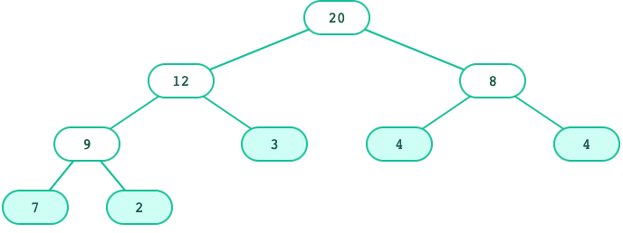
Tree Concepts
Recursive description
A tree has a root label and a list of branches
Each branch is itself a tree
A tree with zero branches is called a leaf
A tree starts at the root
Relative Description
Each location in a tree is called a node
Each node has a label that can be any value
One node can be the parent/child of another
The top node is the root node

Slide 5
Trees: Data abstraction
As a data abstraction, we can have this constructor and these selectors:
tree(label, branches) | Returns a tree with root label and list of branches
label(tree) | Returns the root label of tree
branches(tree) | Returns the branches of tree (each a tree).
is_leaf(tree) | Returns true if tree is a leaf node.
t = tree(3, [
tree(1),
tree(2, [
tree(1),
tree(1)
])])
label(t) # 3
is_leaf(branches(t)[0]) # True
3
1
2
1
1

Slide 6
Tree: One implementation
t = tree(3, [
tree(1),
tree(2, [
tree(1),
tree(1)
])])
3
1
2
1
1
Each tree is stored as a list where first element is label and subsequent elements are branches.
[3, [1], [2, [1], [1]]]
def tree(label, branches=[]):
return [label] + list(branches)
def label(tree):
return tree[0]
def branches(tree):
return tree[1:]
def is_leaf(tree):
return len(branches(tree)) == 0

Slide 8
Working with Trees

Slide 9
Tree processing
A tree is a recursive structure.
Each tree has:
A label
0 or more branches, each a tree
Recursive structure implies recursive algorithm!

Slide 10
Tree processing: Counting leaves
def count_leaves(t):
"""Returns the number of leaf nodes in t."""
if is_leaf(t):
return 1
else:
leaves_under = 0
for b in branches(t):
leaves_under += count_leaves(b)
return leaves_under
What's the base case?
What's the recursive call?

Slide 11
Tree processing: Counting leaves
The sum() function sums up the items of an iterable.
That leads to this shorter function:
sum([1, 1, 1, 1]) # 4
def count_leaves(t):
"""Returns the number of leaf nodes in t."""
if is_leaf(t):
return 1
else:
branch_counts = [count_leaves(b) for b in branches(t)]
return sum(branch_counts)

Slide 12
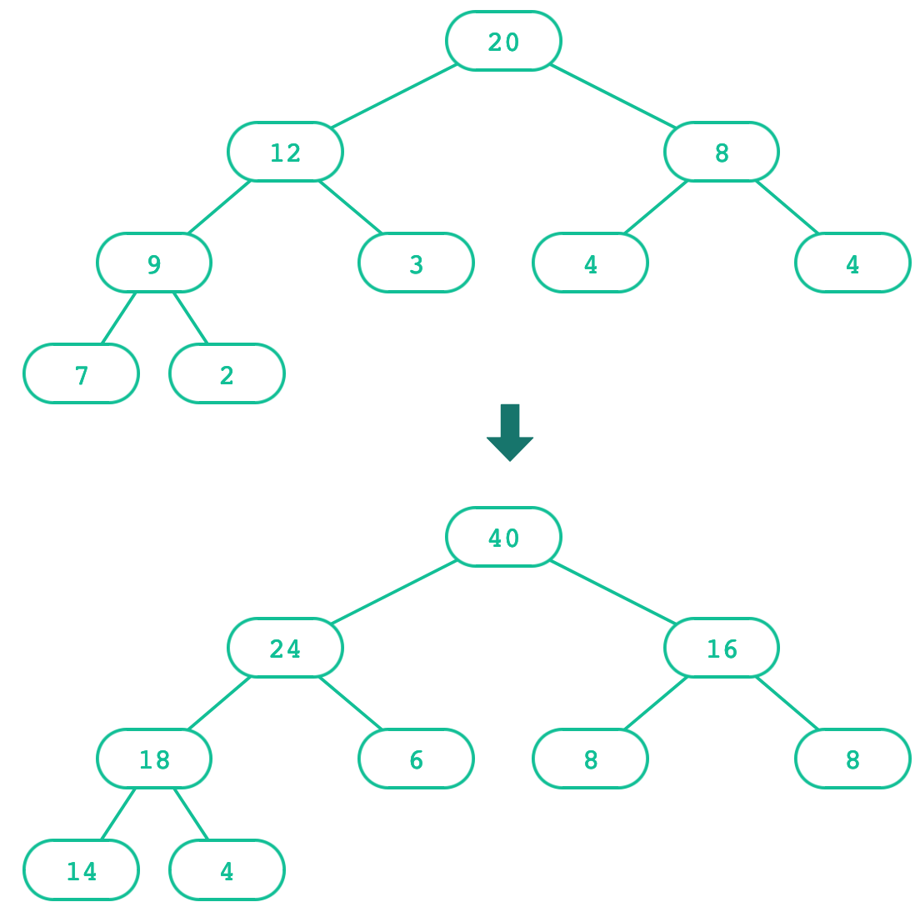
Creating trees
A function that creates a tree from another tree is also often recursive.

Slide 13
Creating trees: Doubling labels
def double(t):
"""Returns a tree identical to t, but with all labels doubled."""
if is_leaf(t):
return tree(label(t) * 2)
else:
return tree(label(t) * 2,
[double(b) for b in branches(t)])
What's the base case? What's the recursive call?

Slide 14
Creating trees: Doubling labels
A shorter solution:
Explicit base cases aren't always necessary in the final code, but it's useful to think in terms of base case vs. recursive case when learning.
def double(t):
"""Returns the number of leaf nodes in t."""
return tree(label(t) * 2,
[double(b) for b in branches(t)])

Slide 15
Exercise: Printing trees
def print_tree(t, indent=0):
"""Prints the labels of t with a depth-based
indent of 2 spaces.
>>> t = tree(3, [tree(1), tree(2, [tree(1), tree(1)])])
>>> print(t)
3
1
2
1
1
"""

Slide 16
Exercise: Printing trees (solution)
def print_tree(t, indent=0):
"""Prints the labels of t with a depth-based
indent of 2 spaces.
>>> t = tree(3, [tree(1), tree(2, [tree(1), tree(1)])])
>>> print(t)
3
1
2
1
1
"""
print(indent * " " + label(t))
for b in branches(t):
print_tree(b, indent + 2)

Slide 17
Exercise: List of leaves
def leaves(t):
"""Return a list containing the leaf labels of t.
>>> t = tree(20, [tree(12, [tree(9, [tree(7), tree(2)])
,tree(3)]), tree(8, [tree(4), tree(4)])])
>>> leaves(t)
[7, 2, 3, 4, 4]
"""
Hint: If you sum a list of lists, you get a list containing the elements of those lists. The sum function takes a second argument, the starting value of the sum.
sum([ [1], [2, 3], [4] ], []) # [1, 2, 3, 4]
sum([ [1] ], []) # [1]
sum([ [[1]], [2] ], []) # [[1], 2]

Slide 18
Exercise: List of leaves (solution)
def leaves(t):
"""Return a list containing the leaf labels of t.
>>> t = tree(20, [tree(12, [tree(9, [tree(7), tree(2)])
,tree(3)]), tree(8, [tree(4), tree(4)])])
>>> leaves(t)
[7, 2, 3, 4, 4]
"""
if is_leaf(t):
return [label(t)]
else:
leaf_labels = [leaves(b) for b in branches(t)]
return sum(leaf_labels, [])

Slide 19
Exercise: Counting paths
def count_paths(t, total):
"""Return the number of paths from the root to any node in t
for which the labels along the path sum to total.
>>> t = tree(3, [tree(-1), tree(1, [tree(2, [tree(1)]), tree(3)]), tree(1, [tree(-1)])])
>>> count_paths(t, 3)
2
>>> count_paths(t, 4)
2
>>> count_paths(t, 5)
0
>>> count_paths(t, 6)
1
>>> count_paths(t, 7)
2
"""

Slide 20
Exercise: Counting paths (solution)
def count_paths(t, total):
"""Return the number of paths from the root to any node in t
for which the labels along the path sum to total.
>>> t = tree(3, [tree(-1), tree(1, [tree(2, [tree(1)]), tree(3)]), tree(1, [tree(-1)])])
>>> count_paths(t, 3)
2
>>> count_paths(t, 4)
2
>>> count_paths(t, 5)
0
>>> count_paths(t, 6)
1
>>> count_paths(t, 7)
2
"""
if label(t) == total:
found = 1
else:
found = 0
return found + sum([count_paths(b, total - label(t)) for b in branches(t)])

Slide 22
Abstraction and Trees

Slide 23
Tree: Layers of abstraction
Primitive Representation | 1 2 3 "a" "b" "c" [.. , ..]
Data abstraction | tree() branches() label() is_leaf()
User program | double(t) count_leaves(t)
Each layer only uses the layer above it.

Slide 25
Trees, Trees, everywhere!

Slide 26
Directory structures
CS 111
Tree for a directory Structure
Homework
Labs
HW01
HW02
HW03
HW04
admissions.py
test_files
Admission_algorithms_dataset.csv
key_outliers.txt
…
key_chosen_students.txt

Slide 27
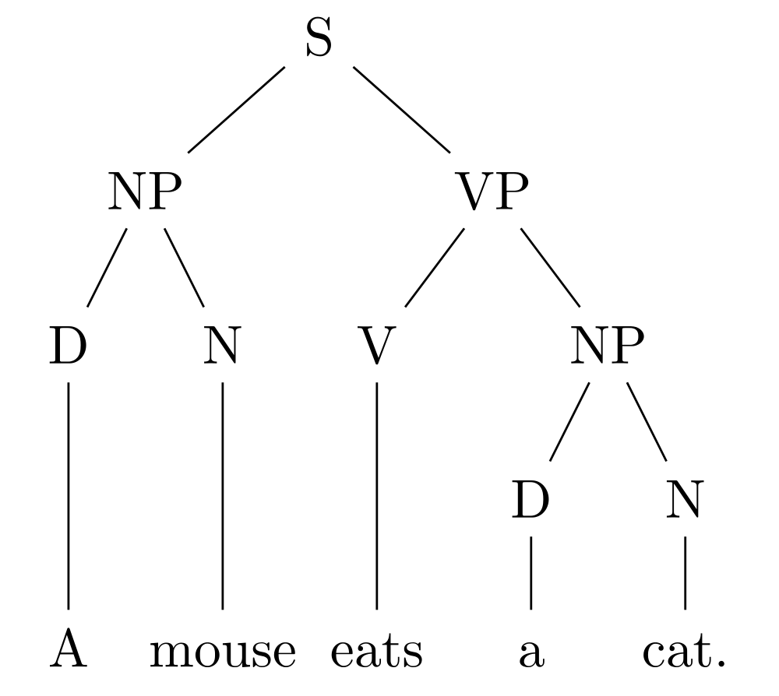
Parse trees
For natural languages …
Key:
S = Sentence
NP = Noun phrase
D = Determiner
N = Noun
V = Verb
VP = Verb Phrase

Slide 28
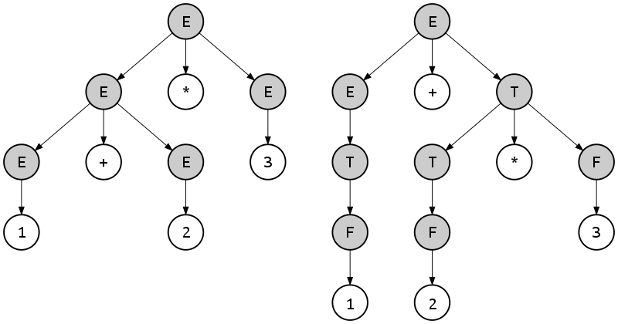
Parse trees
For programming languages, too …
Key:
E = expression
T = term
F = factor

Slide 30
A Tree Class

Slide 31
Trees: Data abstraction (review)
So far, here's what we've been using:
With an implementation like this:
tree(label, branches) | Returns a tree with root label and list of branches
label(tree) | Returns the root label of tree
branches(tree) | Returns the branches of tree (each a tree).
is_leaf(tree) | Returns true if tree is a leaf node.
def tree(label, branches=[]):
return [label] + list(branches)
def label(tree):
return tree[0]
def branches(tree):
return tree[1:]
def is_leaf(tree):
return not branches(tree)
🤔 How could we represent trees as a Python class?

Slide 32
A Tree class
class Tree:
def __init__(self, label, branches=[]):
self.label = label
self.branches = list(branches)
def is_leaf(self):
return not self.branches
🤔 What's different? What's the same?

Slide 33
tree versus Tree
tree | Tree
t = tree(label, branches=[]) branches(t) | t = Tree(label, branches=[])
label(t) | t.label
is_leaf(t) | t.is_leaf()
def fib_tree(n):
if n == 0 or n == 1:
return tree(n)
else:
left = fib_tree(n - 2)
right = fib_tree(n - 1)
fib_n = label(left) + label(right)
return tree(fib_n, [left, right])
def fib_tree(n):
if n == 0 or n == 1:
return Tree(n)
else:
left = fib_tree(n - 2)
right = fib_tree(n - 1)
fib_n = left.label + right.label
return Tree(fib_n, [left, right])

Slide 34
A fancier Tree
class Tree:
def __init__(self, label, branches=[]):
self.label = label
for branch in branches:
assert isinstance(branch, Tree)
self.branches = list(branches)
def is_leaf(self):
return not self.branches
def __repr__(self):
if self.branches:
branch_str = ', ' + repr(self.branches)
else:
branch_str = ''
return 'Tree({0}{1})'.format(self.label, branch_str)
def __str__(self):
return '\n'.join(self.indented())
def indented(self):
lines = []
for b in self.branches:
for line in b.indented():
lines.append(' ' + line)
return [str(self.label)] + lines

Slide 36
Tree mutation

Slide 37
Doubling a Tree
def double(t):
"""Doubles every label in t, mutating t.
>>> t = Tree(1, [Tree(3, [Tree(5)]), Tree(7)])
>>> double(t)
>>> t
Tree(2, [Tree(6, [Tree(10)]), Tree(14)])
"""
t.label = t.label * 2
for b in t.branches:
double(b)

Slide 38
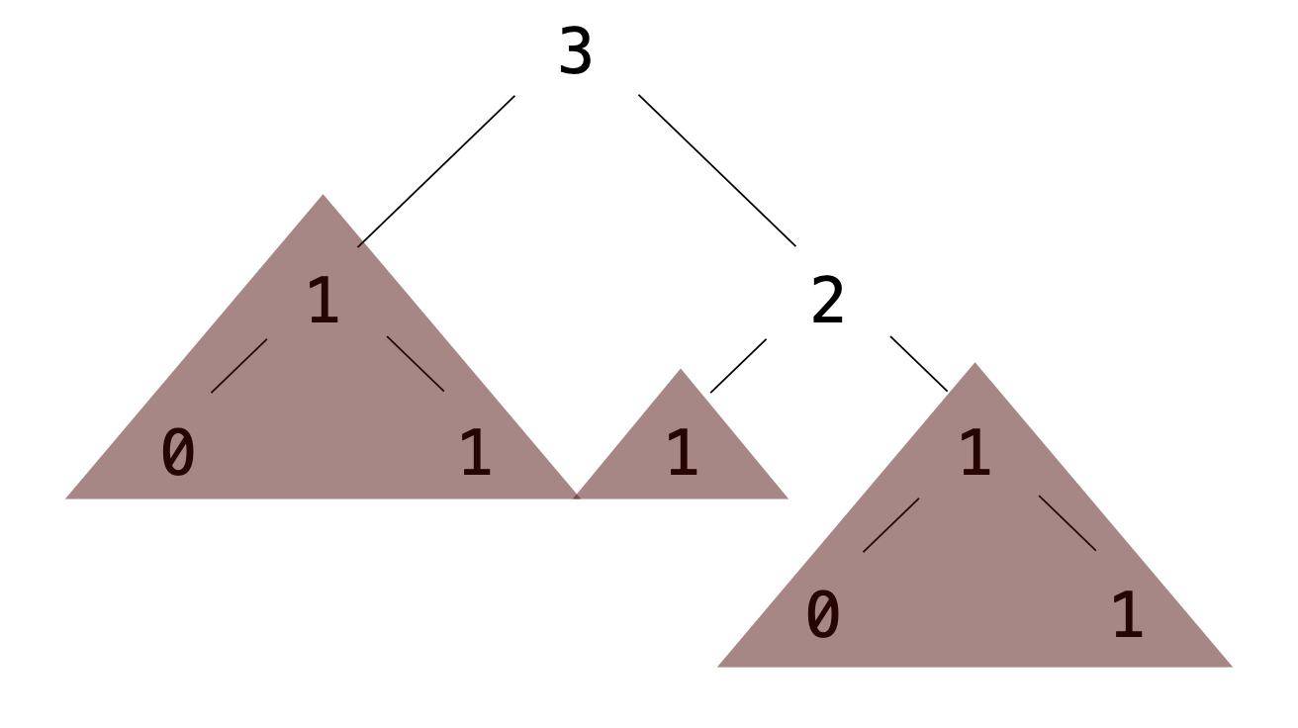
Exercise: Pruning trees
Removing subtrees from a tree is called pruning.
Always prune branches before recursive processing.
def prune(t, n):
"""Prune all sub-trees whose label is n.
>>> t = Tree(3, [Tree(1, [Tree(0), Tree(1)]), Tree(2,
[Tree(1), Tree(1, [Tree(0), Tree(1)])])])
>>> prune(t, 1)
>>> t
Tree(3, [Tree(2)])
"""
t.branches = [___ for b in t.branches if ___]
for b in t.branches:
prune(___, ___)

Slide 39
Exercise: Pruning trees (solution)
Removing subtrees from a tree is called pruning.
Always prune branches before recursive processing.
def prune(t, n):
"""Prune all sub-trees whose label is n.
>>> t = Tree(3, [Tree(1, [Tree(0), Tree(1)]), Tree(2,
[Tree(1), Tree(1, [Tree(0), Tree(1)])])])
>>> prune(t, 1)
>>> t
Tree(3, [Tree(2)])
"""
t.branches = [b for b in t.branches if b.label !=n]
for b in t.branches:
prune(b, n)

Slide 41
Recursive Objects

Slide 42
Recursive objects
Why are Tree and Link considered recursive objects?
Each type of object contains references to the same type of object.
An instance of Tree can contain additional instances of Tree, in the branches variable.
An instance of Link can contain an additional instance of Link, in the rest variable.
Both classes lend themselves to recursive algorithms. Generally:
For Tree: The base case is when is_leaf() is True; the recursive call is on the branches.
For Link: The base case is when the rest is empty; the recursive call is on the rest.

